Slide 1
Computer Security
Lecture 24
CT4005NI - Computer Hardware and Software
Architectures

Slide 2
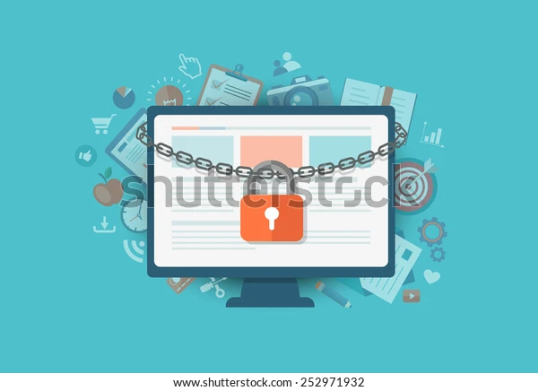
23. Introduction
Private information, company secrets, financial data, computer equipment, and items of national security are placed at risk if proper security procedures are not followed.
Objectives
Explain why security is important.
•Describe security threats.
•Identify security procedures.
•Identify common preventive maintenance techniques.

Slide 3
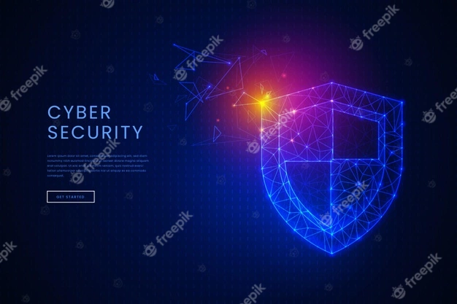
23.1 Why Security is Important?
Computer and network security help to keep data and equipment functioning and provide access only to appropriate people.
Theft, loss, network intrusion, and physical damage are some of the ways a network or computer can be harmed.
Damage or loss of equipment can mean a loss of productivity.

Slide 4
23.1 Why Security is Important?
Repairing and replacing equipment can cost the company time and money.
Unauthorized use of a network can expose confidential information and reduce network resources.
Therefore, primary responsibilities of a technician include data and network security.

Slide 5
23.2 Security Threats
Threats to Computer Security
Physical – Events or attacks that steal, damage, or destroy equipment, such as servers and switches.
Data – Events or attacks that remove, corrupt, deny access, allow access, or steal information

Slide 6
Source of Threats
Internal - Employees have access to data, equipment, and the network
Malicious threats are when an employee intends to cause damage.
Accidental threats are when the user damages data or equipment unintentionally.
External - Users outside of an organization that do not have authorized access to the network

Slide 7
Source of Threats
Unstructured – Attackers use available resources, such as passwords or scripts, to gain access
Structured – Attackers use code to access operating systems and software.
Physical loss or damage to equipment can cost money and reputation of your company.
Data threats are constantly changing as attackers find new ways to gain entry to your system.

Slide 8
Grayware/Malware
Grayware or malware is a file or program that is potentially harmful.
Many grayware attacks are phishing attacks where users are persuade to provide their credentials.
It can be removed using spyware and adware removal tools.

Slide 9
Viruses
A virus is a program written with malicious intent and sent out by attackers.
It is transferred to another computer through e-mail, file transfers, and instant messaging.
When the file is accessed, the virus executes and infects the computer.
It has the potential to corrupt or even delete files on your computer.
Stealth viruses can infect a computer and lay dormant until summoned by the attacker.

Slide 10
Worms
A worm is a self-replicating program that is harmful to networks.
It duplicates its code over the network to the hosts, often without any user intervention.
It doesn't attach itself to a program to infect a host.
Though worms doesn't damage data or applications, it is harmful to network, as it consumes bandwidth.

Slide 11
Trojans
Trojans are often disguised as useful software.
It is hidden in software that appears to do one thing, and yet behind the scenes it does another.
An infected computer in a network could be sending critical data to others along with Trojan horses.
Anti-virus is software designed specifically to detect, disable, and remove viruses, worms, and Trojans before they infect a computer.

Slide 12
Adware
Adware is a software program that displays advertising on your computer.
Usually distributed with downloaded software.
Most often, adware is displayed in a popup window.
Adware popup windows are difficult to control and opens new windows faster than users can close them.

Slide 13
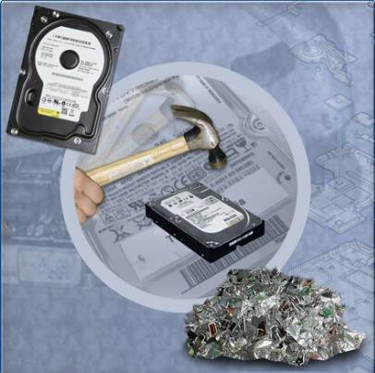
Data Wiping, Hard Drive Destruction and Recycling
Data Wiping
Data wiping, also known as secure erase, is a procedure performed to permanently delete data from a hard drive.
It is performed on hard drives containing sensitive data such as financial information.
It is not enough to delete files or even format the drive.

Slide 14
Hard Drive Destruction
Companies with sensitive data should always establish clear policies for hard drive disposal.
Destroying the hard drive is the best option for companies with sensitive data.
To fully ensure that data cannot be recovered, one should carefully shatter the platters with a hammer and safely dispose the pieces.
Other storage media, like CDs, must also be destroyed using Shredding Machine.

Slide 15
Hard Drive Recycling
Hard drives that do not contain sensitive data should be reused in other computers.
It can be reformatted or reinstalled.

Slide 16
23.3 Identify Security Procedures
16.3.1 Basic Local Security Policy
A security policy should describe how a company addresses security issues.
Though local security policies may vary between organizations, there are questions all organizations should ask:
What assets require protection?
What are the possible threats?
What to do in the event of a security breach?
Security policies should be reviewed regularly and updated as necessary.
Password guidelines are an important component of a security policy.
You should also define employee access to data (Public, Top Secret) in a security policy.

Slide 17
Password guidelines
Password should be unique and should not contain person’s or organization First name and Last name.
Password should contain letters, numbers and special characters(symbols) and also have Uppercase and Lowercase letters.
Password should be long enough at least 8, but longer is preferred.
Password should not be shared with others.
Password should be changed in a certain time.
Do not use same password for different websites or logins. Like do not use same password for your bank account, Facebook, YouTube or any other services.
eg: As54@97h#n

Slide 18
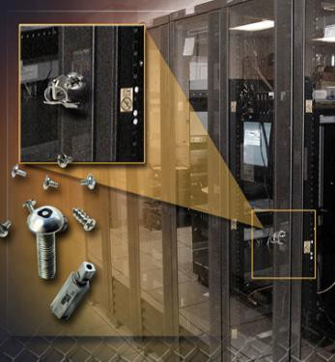
23.3.2 Protecting Physical Equipment
Physical security is as important as data security. When a computer is taken, the data is also stolen.
Methods to physically protect computer equipment:
Control access to facilities.
Use cable locks with equipment.
Keep telecommunication rooms locked.
Fit equipment with security screws.
Use security cages around equipment.
Label and install sensors, such as RFID tags, on equipment.
Install physical alarms triggered by motion-detection sensors.
Use CCTV cameras .

Slide 19
23.3.2 Protecting Physical Equipment
Protecting access to the facility
Card keys
Biometric
Security Guard
Sensors

Slide 20
23.3.3 Ways to Protect Data
Password Protection
BIOS – Prevents the operating system from booting, and prevents BIOS settings from being changed.
Login – Prevents unauthorized access to the local computer and the network
Data Encryption
Traffic between resources and computers on the network can be protected from attackers monitoring or recording transactions by implementing encryption. Example: VPN.
Software Firewall
A software firewall is a program that runs on a computer to allow or deny traffic between the computer and the network to which it is connected.

Slide 21
23.3.3 Ways to Protect Data
Data Backups
Backing up data is one of the most effective ways of protecting against data loss.
Frequency of backups: daily, weekly, monthly.
Storage of backups: stored in offsite location.
Security of backups: protect with passwords.

Slide 22
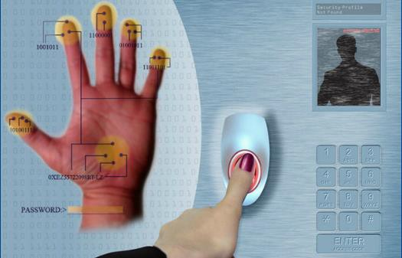
Biometric Security
Biometric security compares physical characteristics against stored profiles to authenticate people.
Biometric Devices :
Fingerprint Sensor
Face recognition
Retina Scanner

Slide 23
End of Lecture 24

